Slide 1

Welcome to EECS16A! Designing Information Devices and Systems I
Grace Kuo, Urmita Sikder, and Panos Zarkos
June 22, 2020
Lecture will start at 9:40 am PST
Notes:
Everything is on Berkeley time

Slide 2
First Lecture Plan
Introductions
Administrative Details (discussions, homework, etc.)
Overview of 16A’s material and how it fits into EECS
Start with module 1

Slide 3
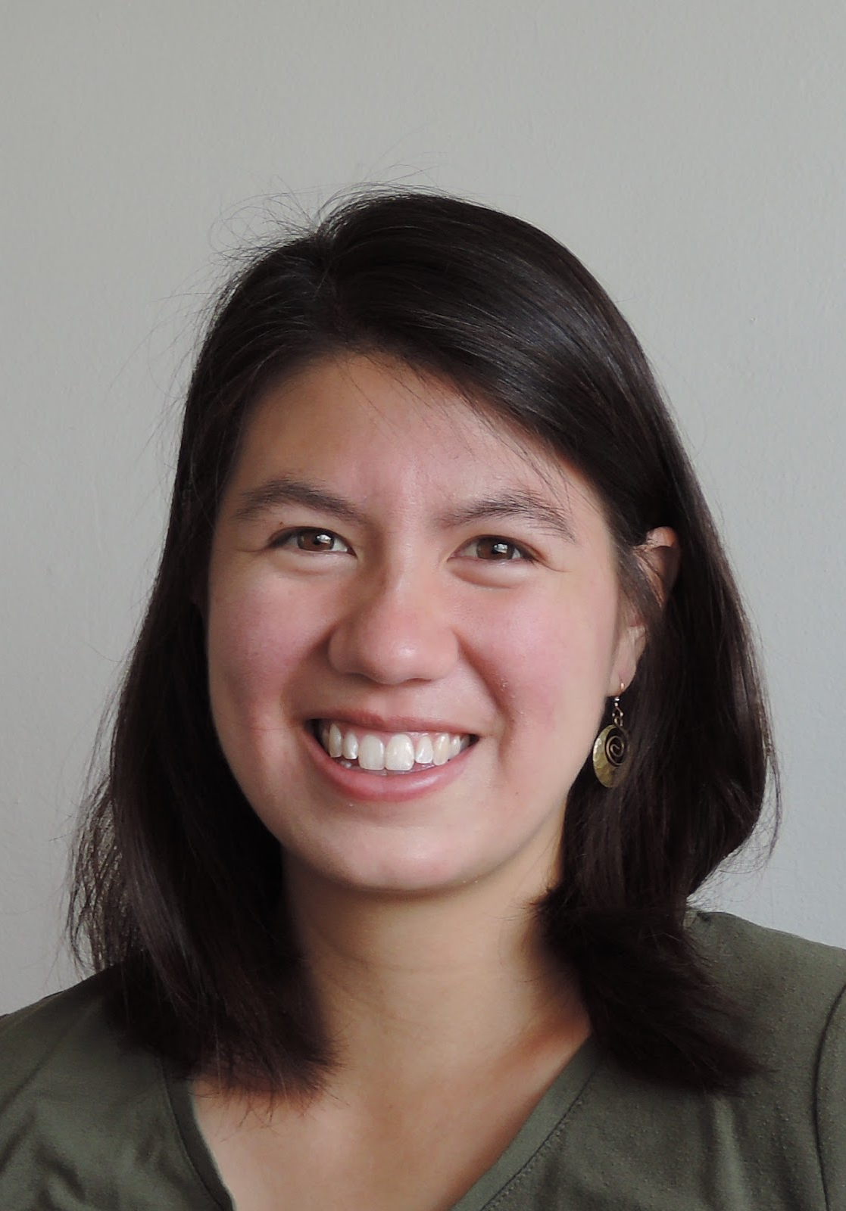
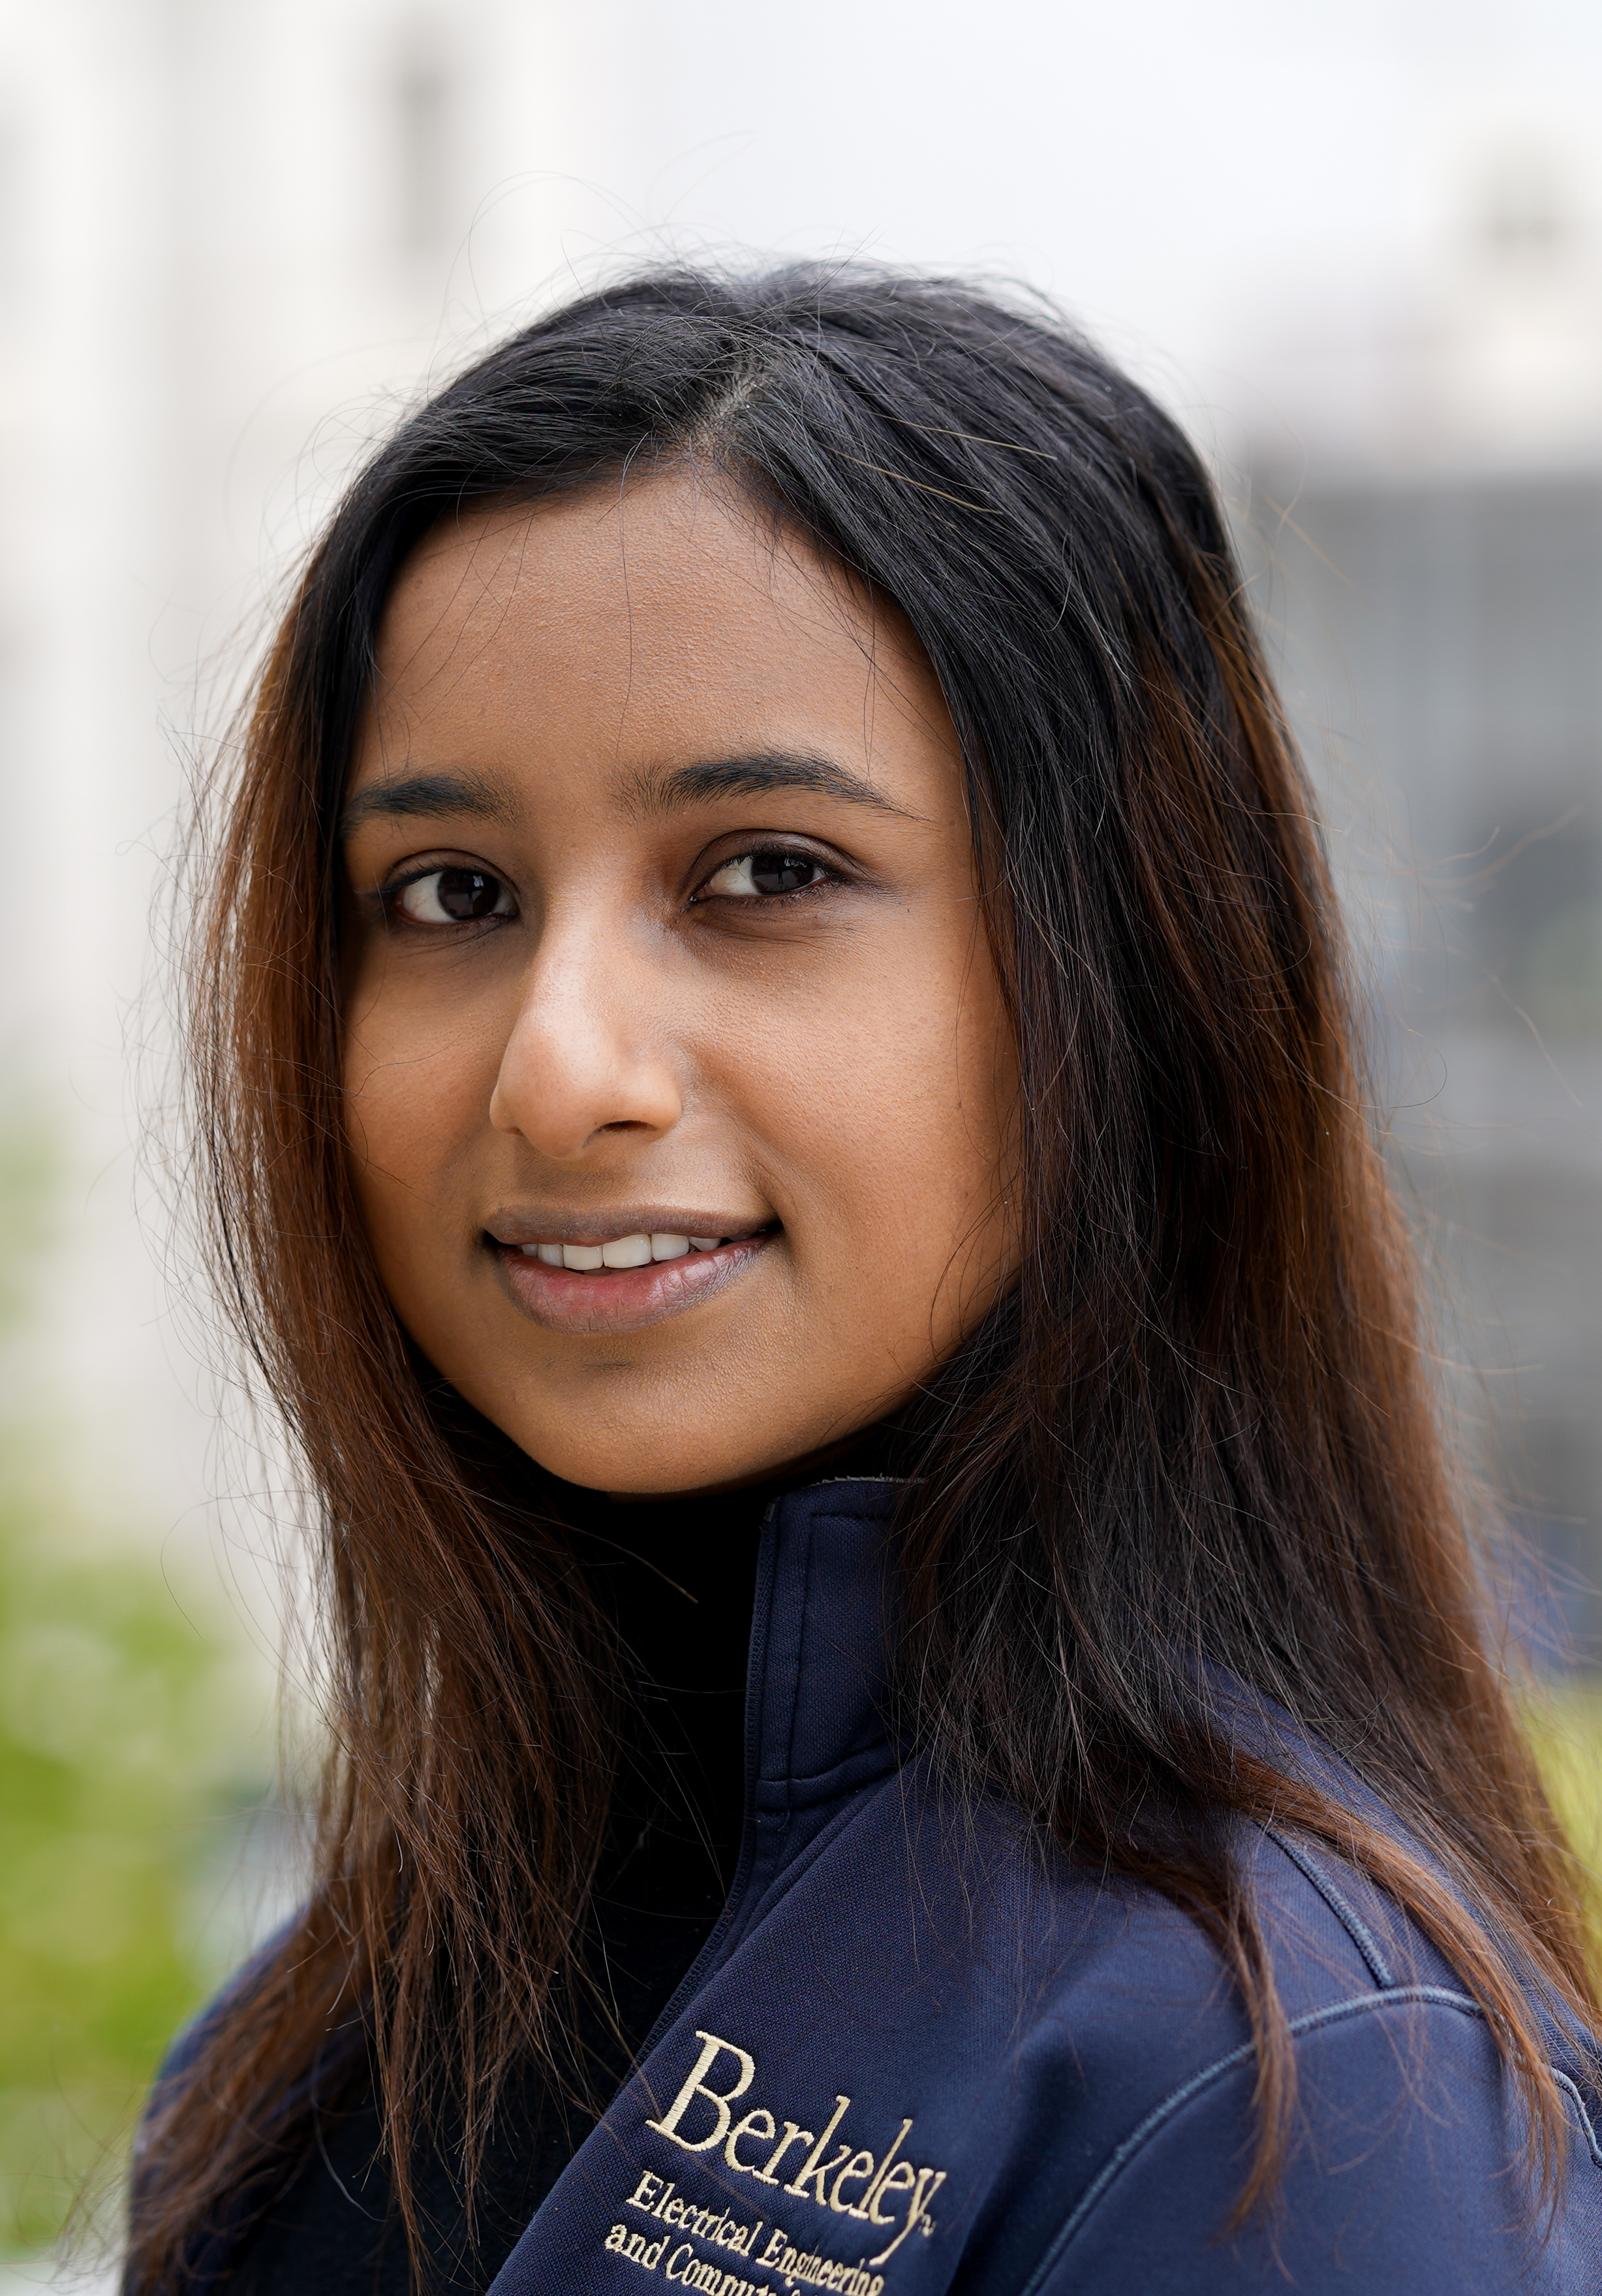
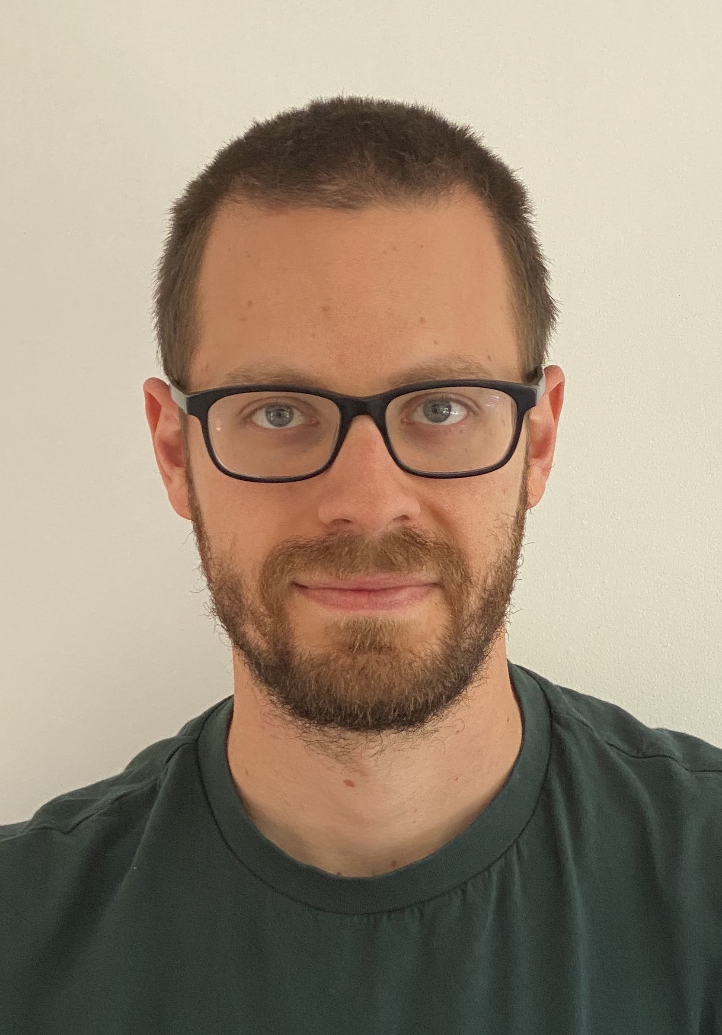
Instructors
Prof. Grace Kuo
gkuo@berkeley.edu
Prof. Urmita Sikder
urmita@berkeley.edu
Prof. Panos Zarkos
panzarkos@berkeley.edu
Prof. OH are immediately after lecture at the same zoom link. Just stay online!

Slide 4

Head GSI
Head GSI:
eecs16a@berkeley.edu
Email with:
Questions not for Piazza
All conflicts
Any emergencies
Administrative questions
Sam Weismann
Notes:
Put in gsi names, check grace/Hannah emails and add pics

Slide 5
Some logistics
EECS 16A website, 16A Progress Tracker
https://www.eecs16a.org
Piazza
https://piazza.com
Gradescope
https://www.gradescope.com
Slack
Please bear in mind: There are humans on the other end of these resources!
Notes:
Website: calendar, hw, course policies
Piazza: important announcements as well as zoom links
Role of slack: facilitate discussion, keep using after discussion is done, hw and exam study groups groups
Be respectful of course
No official announcements, ask for help on piazza

Slide 6
Lots of you, but lots of us too!
16 TAs
Lots of different technical areas and interests represented (by design)
6 Academic Student Employees…
Former 16A students just like you …
The path to being on 16A staff
Do great in 16A
Become an Academic Student Employee
Grade homeworks, assist in labs, tutor and help out in OH, work on improving the notes …
Become a uGSI
Become faculty!
Notes:
Intro TAs

Slide 7
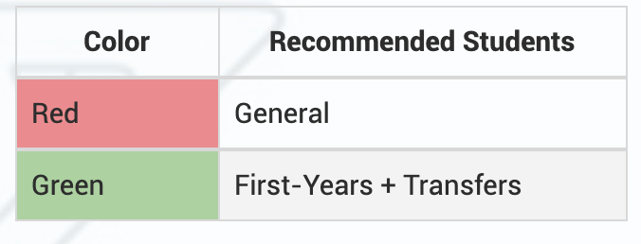
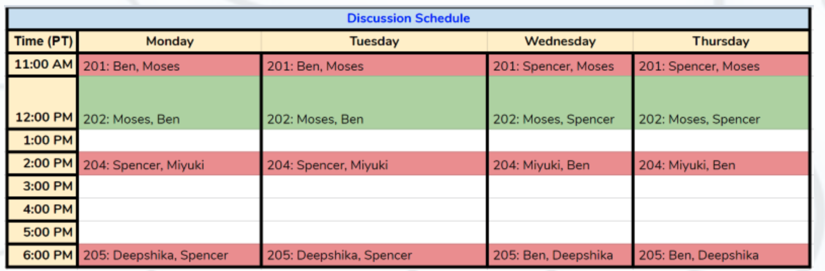
Discussions
Note: Discussions start tomorrow, and lag 1-2 lectures by design.
Notes:
able to attend any discussion
attend one every day M-Th

Slide 8
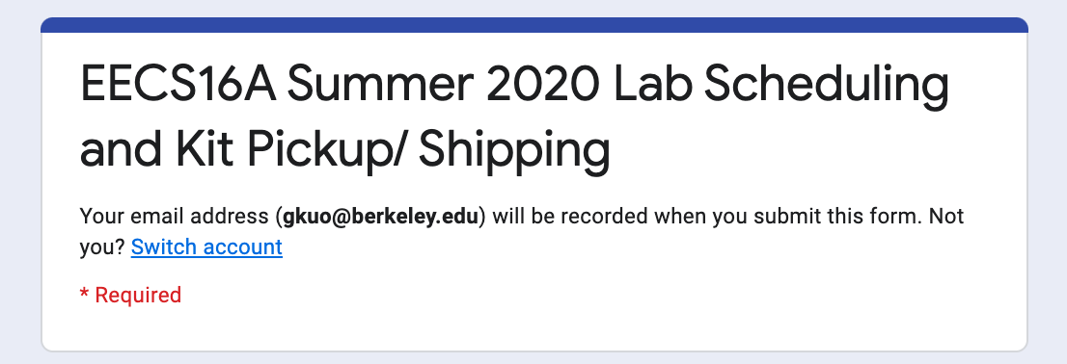
Labs + Lab Kits
Attend your assigned lab section on CalCentral
Labs start this Wednesday/Thursday
Remote labs: get your lab kit!
You won’t need the kit until next week
Contact eecs16a@berkeley.edu ASAP if you didn’t fill out this form:
Notes:
Go to your assigned lab on calcentral
2 labs per week, if one is on the website attend lab
You’ll need to get checked off in your section! As close to in person as possible.
- you’ll need a lab kit. Won’t need until next week.
– should have filled out this form. This is first time we’re doing this
- if you live in the U

Slide 9
Course audience -- YOU
Freshmen and incoming junior-transfers
Sophomores who for some reason were unable to take the class their first year
We assume no prior background in linear algebra or physics

Slide 10
Homeworks
Two homeworks per week – this class is fast paced!
Due Wednesday at midnight, Sunday at midnight
Note: HW 0A will be released today, and is due this Wednesday (6/24) at 11:59pm PST
HW Party: Tues 6-8pm and Fri 2-4pm
OH: See website
Self-grades due with the following homework
Resubmissions due along with self-grades
HW scores are computed according to a complicated but forgiving formula. The emphasis is on learning!
Notes:
Exams are based on the HWs
Different types of problems --- help everyone find their niche
Self grades as well as reader grades -- go back and look at the solutions. Reader grades are for balance

Slide 11
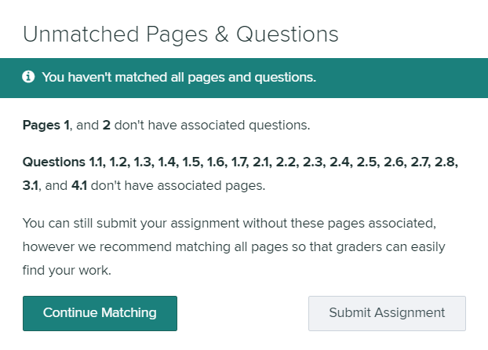
Homework Submission
Homework submitted on Gradescope (if you haven’t been enrolled, email eecs16a@berkeley.edu) You must select pages
You must submit printout of iPython code (see syllabus)

Slide 12
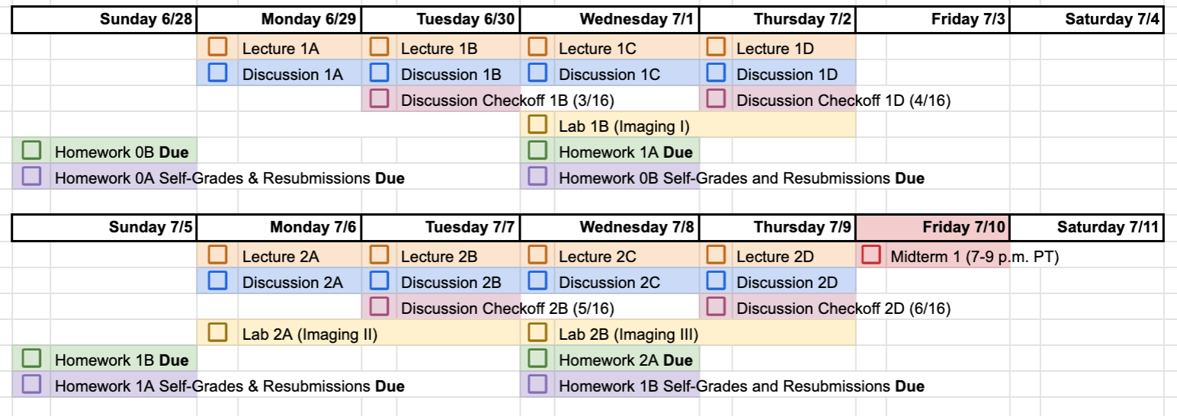
Progress Tracker
To make a copy of the 16A Progress Tracker for yourself, see Piazza or click here.

Slide 13
Course policies
Our goal: Learning
Policies are designed around this
Come to us when you need help
Syllabus is on course website
Please read and follow all course policies listed.
Grading is absolute (no curve)
You are not competing against one another
Notes:
Be respectful of staff time

Slide 14
Course culture
Positive and fun learning environment.
Learning can be hard.
Collaborate and help each other out.
Build community. HW parties, discussion, lab are great places to make friends.
Encourage different perspectives --- this is built into the material, different types of problems, different types of material, different personalities.
Notes:
Goal is to learn about new things. So if you’ve heard about something before --- help out a friend and learn to teach it to them. If something is new to you, then great. That’s the point. If you already knew everything in the course, this wouldn’t be a very worthwhile course. Our goal is not to judge you or weed people out, we want to instead build a community where everyone can be successful.
Intro to your neighbour
Don’t cheat
Introduce yourself to your neighbor
No judgements
Condescending behavior is not tolerated

Slide 15
Course culture
We believe that Black Lives Matter.

Slide 16
How to succeed in16A
Consider your time commitments (ex. other classes)
Attend lecture “live” (freshmen and junior transfers)
Actively read notes, mark what is challenging
Attend discussion “live”
Try HW on your own, early on
Discuss problems with study group and/or at HW Party
Ask questions and help others on Piazza
Hand write HW on your own
Reflect on solutions while self-grading
Study with others as well as alone.
Seek and offer help.
We are here to help you and to have you succeed!
Notes:
Attend lecture “live” – fast paced, easy to get behind
Resources: hw party, OH, piazza, notes

Slide 17
Acknowledgements
We may be the Summer 2020 face of EECS16A, but…
This course is the result of an ambitious curriculum revision by the department.
Many people invested a lot of time to develop the 16x series and make it a success:
A partial list of contributing faculty: Elad Alon, Babak Ayazifar, Miki Lustig, Michel Maharbiz, Ali Niknejad, Gireeja Ranade, Anant Sahai, Vivek Subramanian, Claire Tomlin, Laura Waller, Vladimir Stojanović
And many, many students!
Notes:
ADD VLAD!

Slide 18
Let’s get started…

Slide 19
Did you know…
The same idea that allows an autonomous car drive in a straight line,
Also lets search engines rank webpages,
And lets us train deep learning neural networks.
Eigenvalues and eigenvectors!
Notes:
Help with the analysis of feedback and stability of systems.

Slide 20
Did you know…
That the same idea that makes Shazam work
Also make the GPS on your phone work?
Cross-correlation!

Slide 21
Did you know…
A fundamental algorithm in machine learning and artificial intelligence
Is used to make predictions in biology, brain-machine interfaces, social sciences, imaging algorithms and more?
Least-squares!

Slide 22
Learning goals
Not a survey class --- rigorous and deep
16A
Module 1: Introduction to systems
How do we build a model?
Module 2: Introduction to circuits and design
How do we use a model to solve a problem?
Module 3: Introduction to Machine Learning
How do we “learn” models from data?
16B
Module 4: Advanced circuit design
Module 5: Introduction to robotics
Module 6: Introduction to unsupervised learning
Notes:
Rigorous foundation, learning new
1. Take abstract unstructured → formuation you can work with
2. Models are good, but how to actually build things in the .Focus on design. Circuits, circuit models → real designs
3. Learn from data rather than guessing a model, and we’ll introduce some ideas in machine learning
16B picks ups from here and builds on 16A
It was very important here to have two different backgrounds among people who were designing the course. Elad (who was my co-designer on the circuits and physical side) and I went back for hours and even weeks and months on the order and choice of topics here, and we got feedback from others who were helping out with the course as well as graduate and undergraduate students.

Slide 23
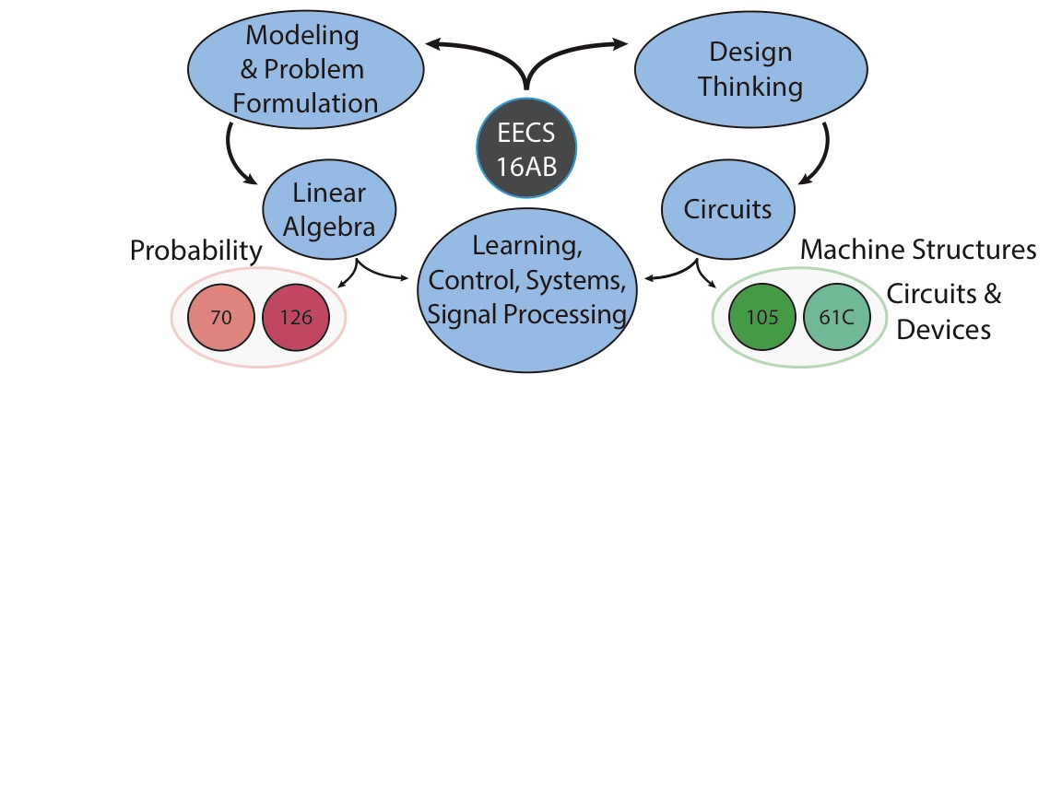
How to approach something unfamiliar and systematically build understanding
Linear Algebra: conceptual tools to model
Circuits: How to go from model to design, grounded in physical world
Intro to foundational concepts in Machine Learning
Notes:
70: Learn how the national program to match medical residents with hospitals works, and where the fundamentals of probability come from
126: Learn how many people you need to sample if you wanted to get accurate results from an election
118/123: Signal processing + Optical systems + computational imaging --- e.g. the types of techniques used to create the black hole image that people are talking about.
127: Fundamental principles of optimization --- basic algorithms behind training of neural networks etc.
05/140: Learn how to build and optimize the circuits underlying all of your smart devices, including touchscreens, heart rate monitors, Face ID, ...
130: Learn how to the devices underlying all modern computation really work
134: Learn how solar cells work and how to optimize them

Slide 24
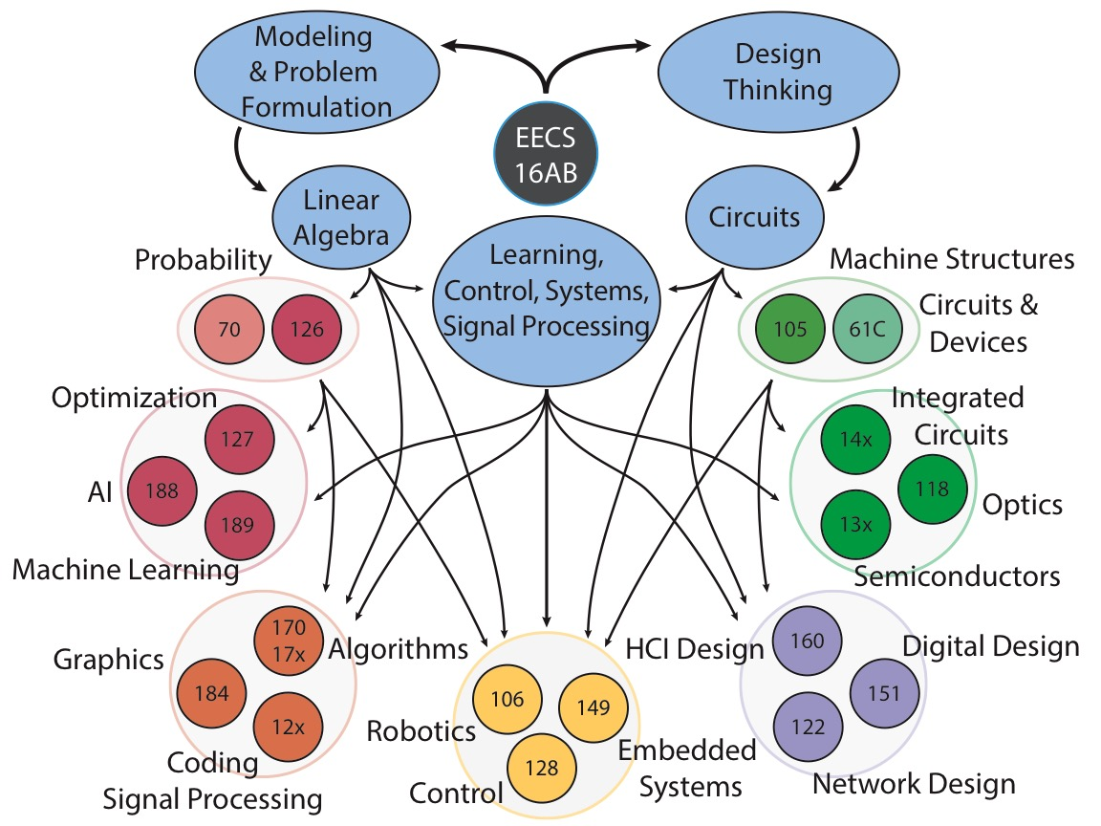
Thanks: Sahaana Suri
Notes:
This will give you an idea of the many different things you can do in EECS.
There is a spot in this dept for each one of you. You don’t have to like everything, but take this course will help you find the part of the department that’s right for you.
Much of the new technology being developed today, for instance at places like Microsoft, is a combination of ideas from EE and CS. Much of my personal research is motivated by the Internet of Things, which is a great example of EE and CS ideas coming together. The next generation of innovators needs to be able to go back and forth between the two fields.
EE127 is core material related to 189 and many people don’t realize that

Slide 25
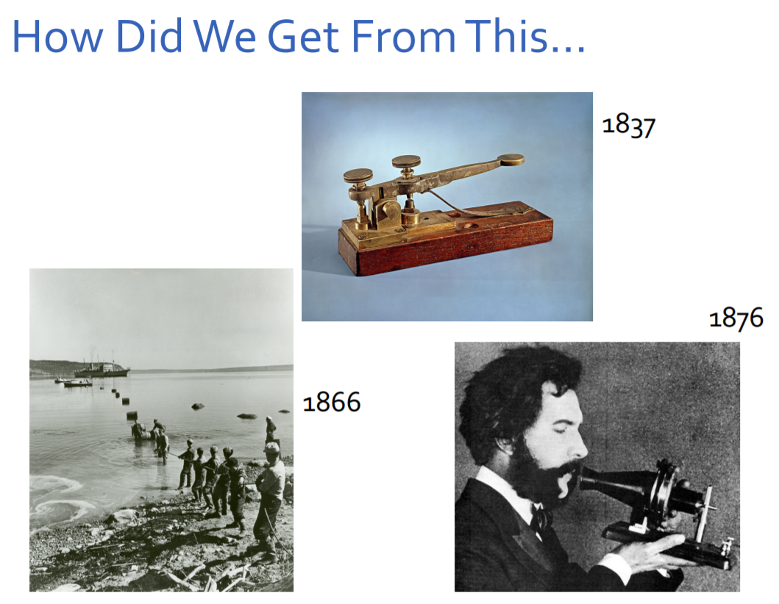
Notes:
Communications examples that required a LOT of engineering
Top: telegraph, attributed to Morse (of Morse code fame), press the lever and it sends messages in binary (long or short pulse).
Bottom Left: trans-Atlantic cable, didn’t work first time because engineers didn’t correctly model how the power travels through (and decays) through the wire. An example of not understanding what problem to solve in the first place, and the importance of modeling
Bottom right: telephone (Alex graham-bell)

Slide 26
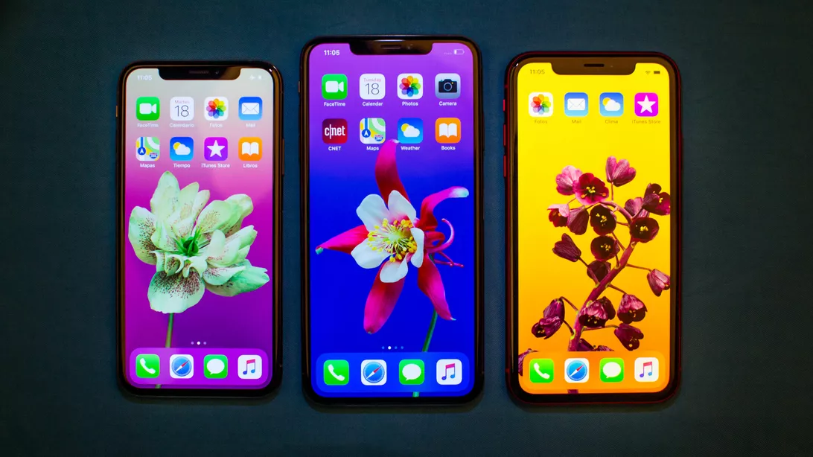
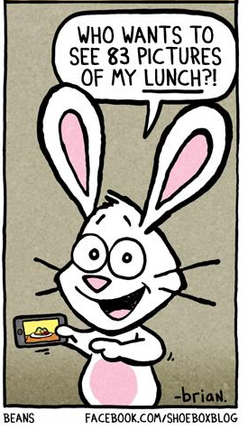
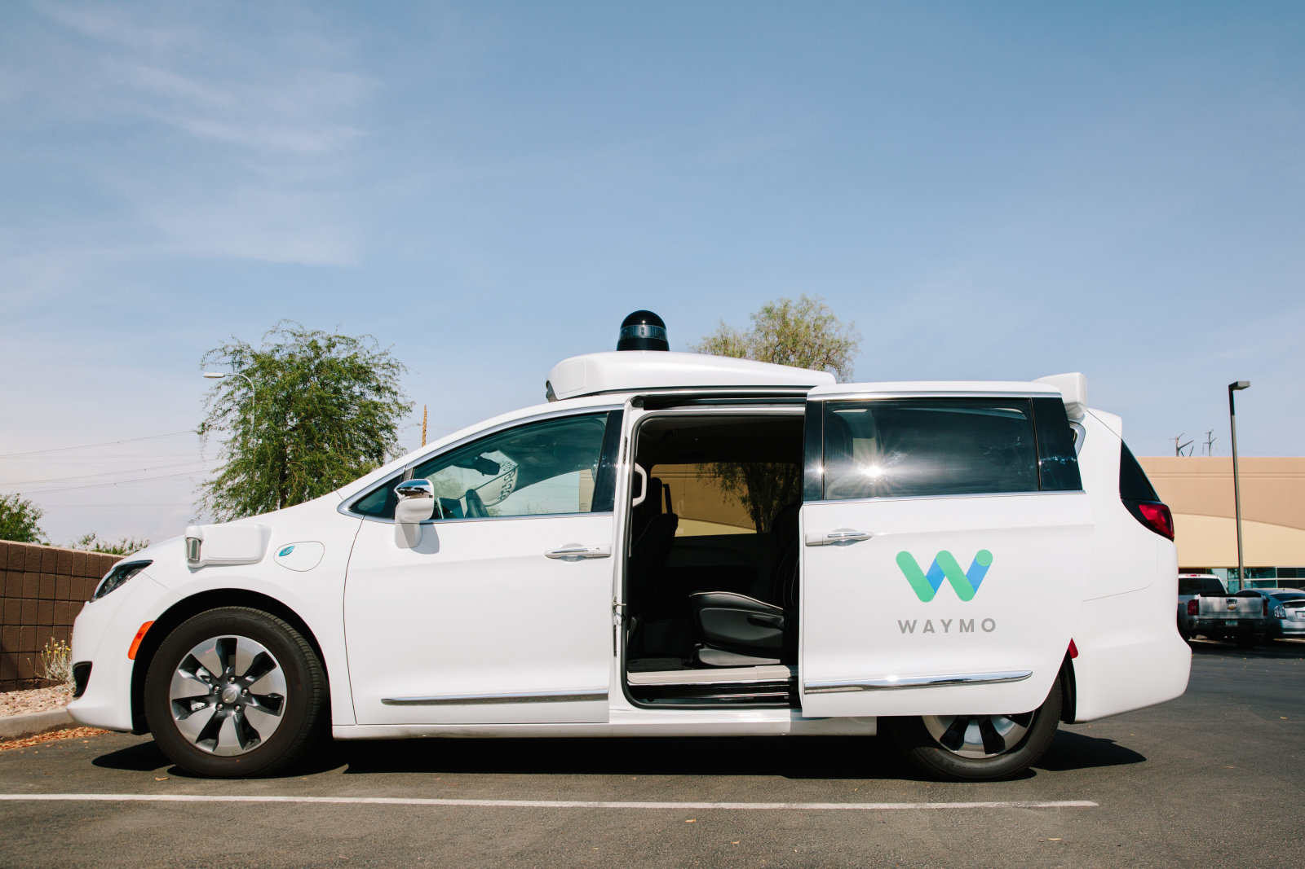
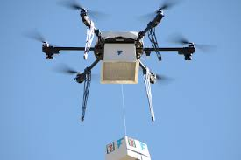
To this?

Slide 27
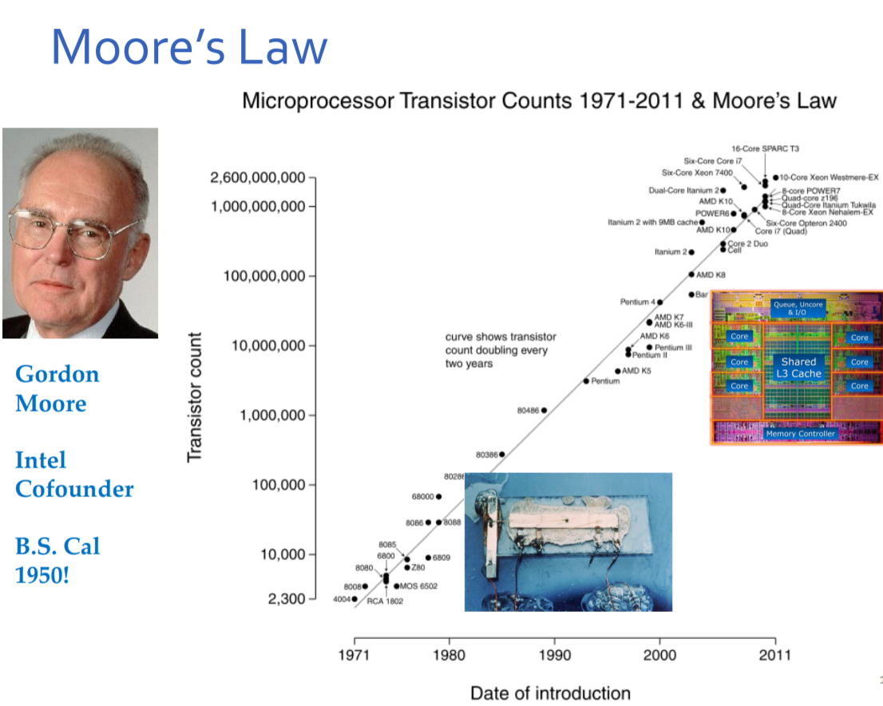
What is a transistor?
Notes:
Moore’s Law: the number of transistors you can put on a silicon chip roughly doubles every 2-3 years or so
Moore was Berkeley grad, cofounded Intel
What’s a transistor? (discuss one min) How would you explain so my mother can understand?
An electronic switch.
All electronics is based on being able to make very small fast and cheap switches (like the telegraph).
Over last 40 years, we’ve gotten 6 orders of mag increase in the switches we can build, so massive transition over short time! Can build super complicated systems
e.g. 2.6 Billion transistors on a chip now, can’t worry about how each electron flows, need to apply abstraction and multi-step thinking → KEY in this class

Slide 28
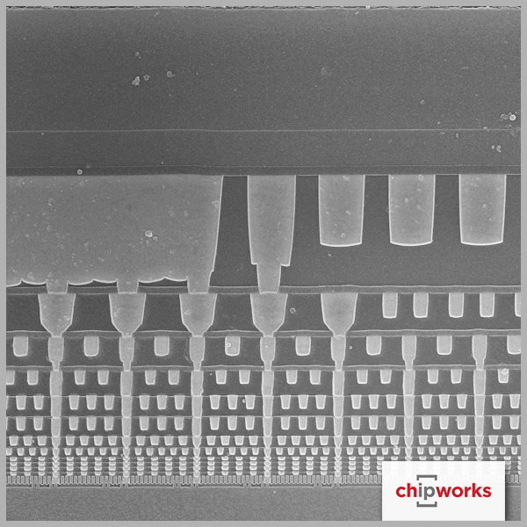
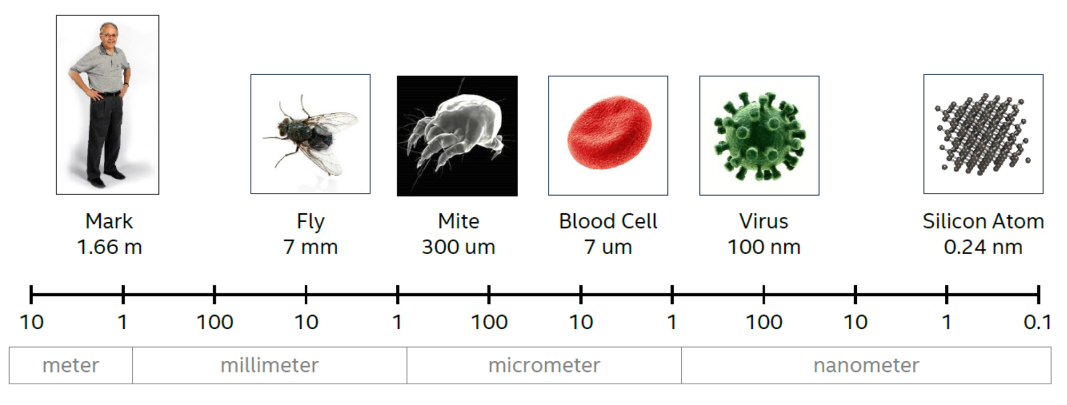
Sense of Scale
Side view of wiring layers
Source: Mark Bohr, IDF14

Slide 29


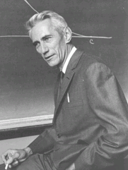
Completing the puzzle …
Ada Lovelace - wrote the first computer program
Turing – invented the Turing machine – how to build a computer to execute programs – what is actually computable?
Claude Shannon – info theory, + how to implement logic out of EM switches
Notes:
Turing was first gay man in computers (also first man) (also first person). Helped win the war by cracking the code for Enigma machine to spy on Germans – some say this saved 14M lives.
Died early at 41 (1952) of cyanide poisoning, likely suicide after being prosecuted for homosexual acts.
Considered the father of CS and AI, he could have otherwise lived to see his work transform the world.
These folks figured out fundamental limits on what’s possible so we can build up to the high tech we have today.

Slide 30
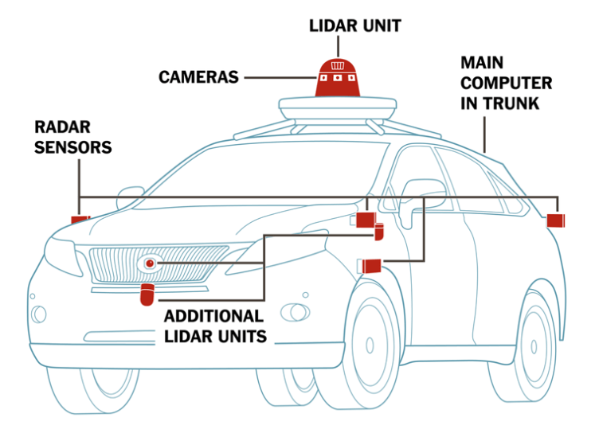
Components of a Complete System
Autonomous Vehicle
Sense
LiDAR
Camera
Processing
Sensor Processing
Decision Making
Actuate
Action Engine
Vehicle Controls

Slide 31
Design of Information Devices and Systems
16a
Real World
Sense
Process
Actuate
16b
Best when hardware and software work together
Best algorithms and best code written by understanding the sensing and compute mechanisms
Best devices designed understanding the physical limitations

Slide 32
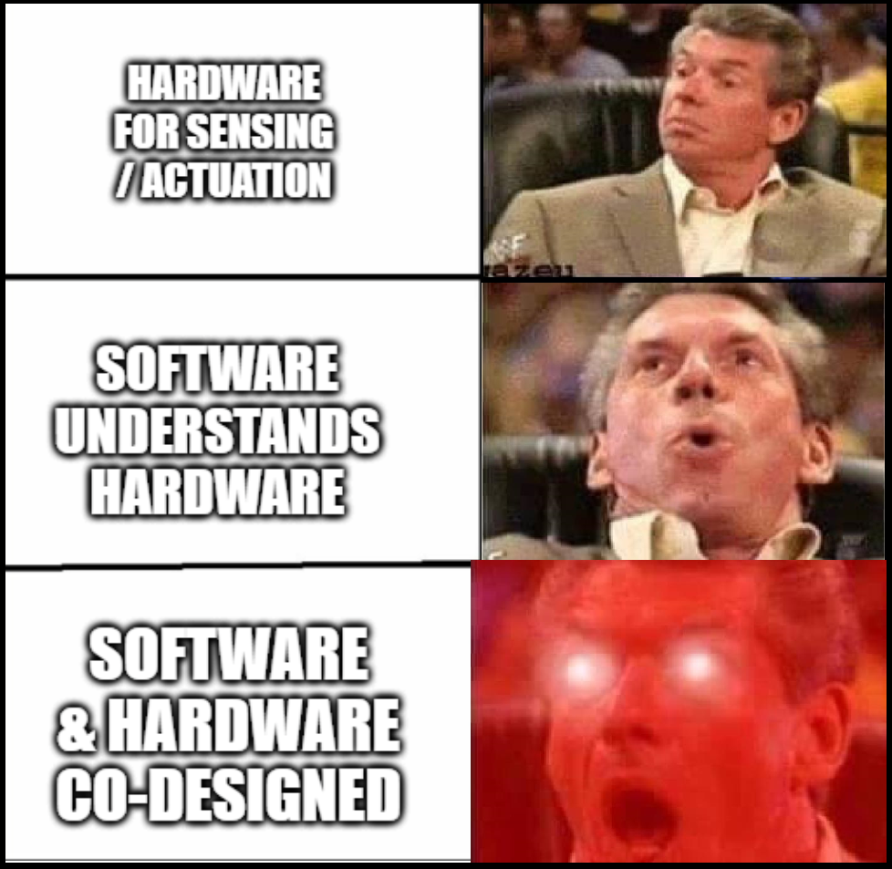
Integrated Designs

Slide 33
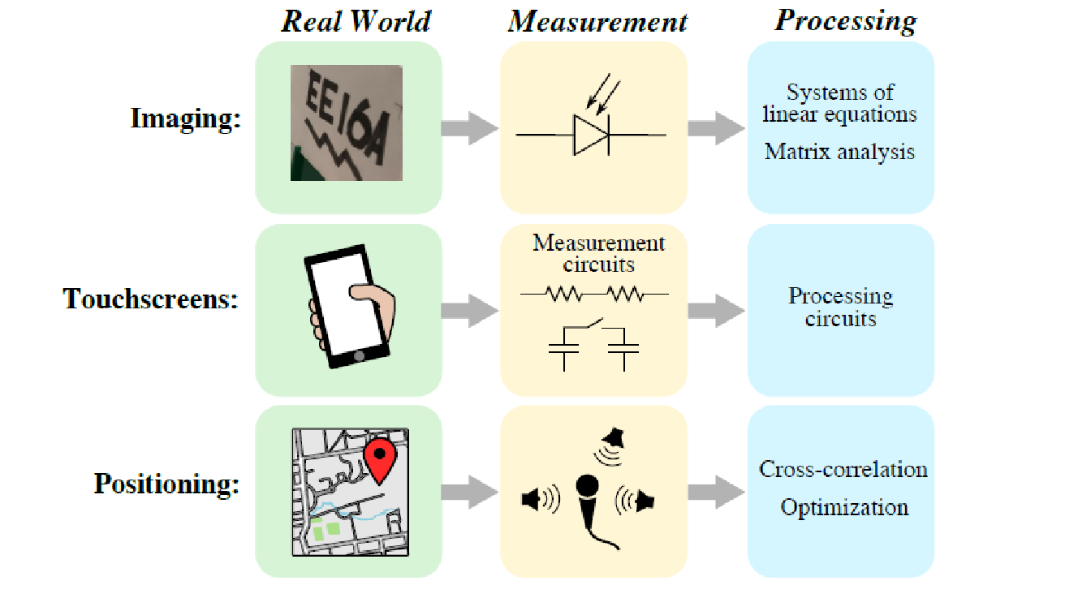
16A Examples

Slide 34
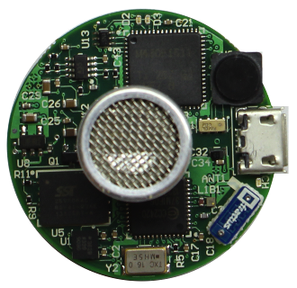
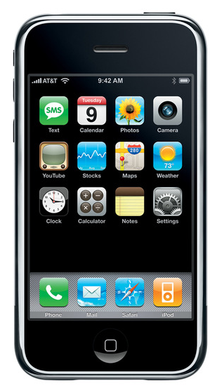

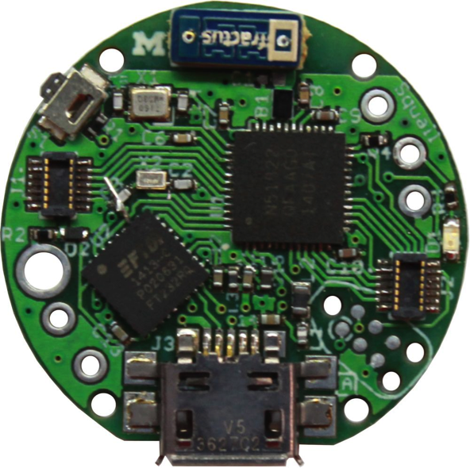
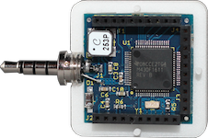
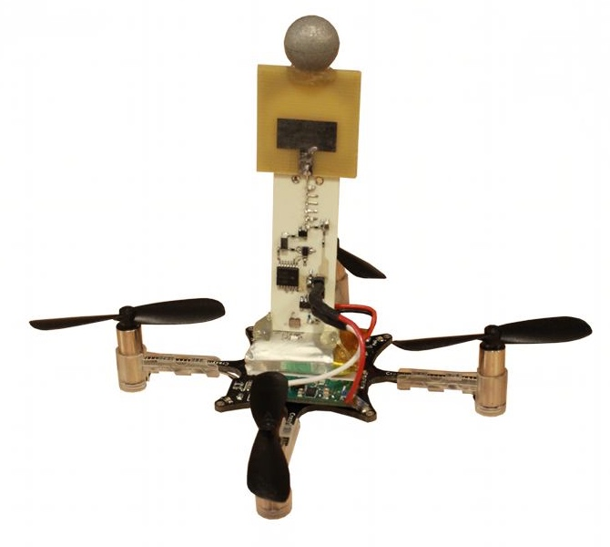
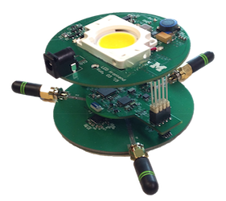


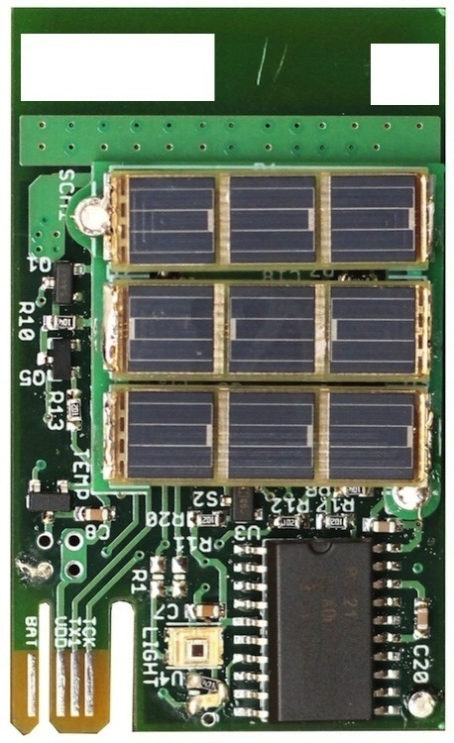
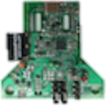

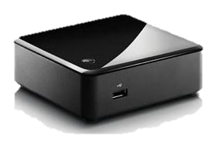
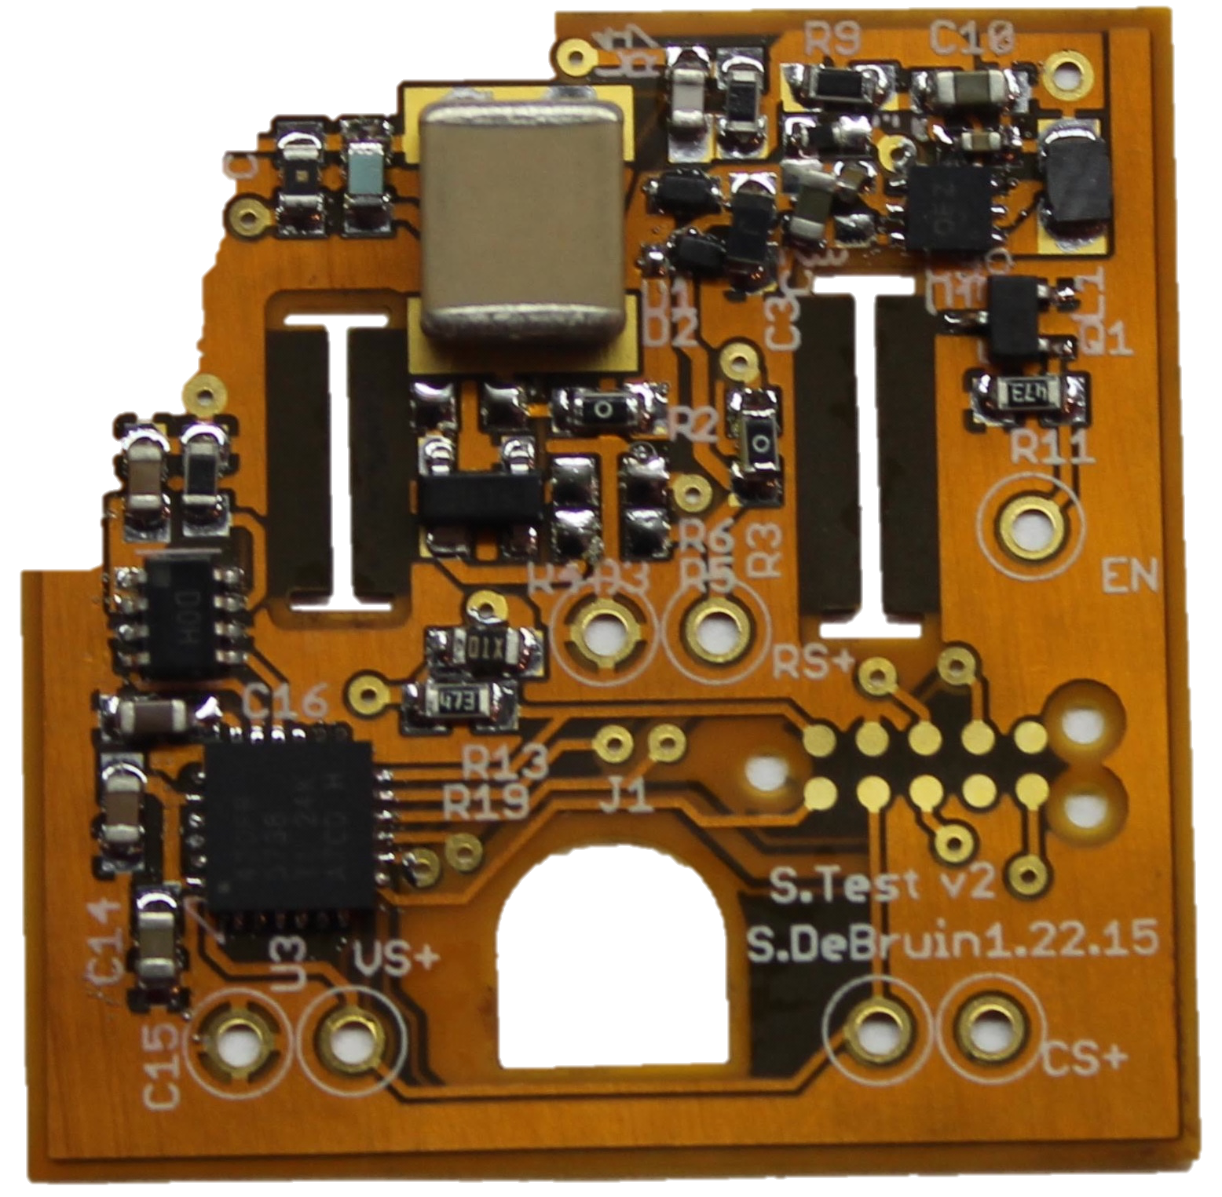
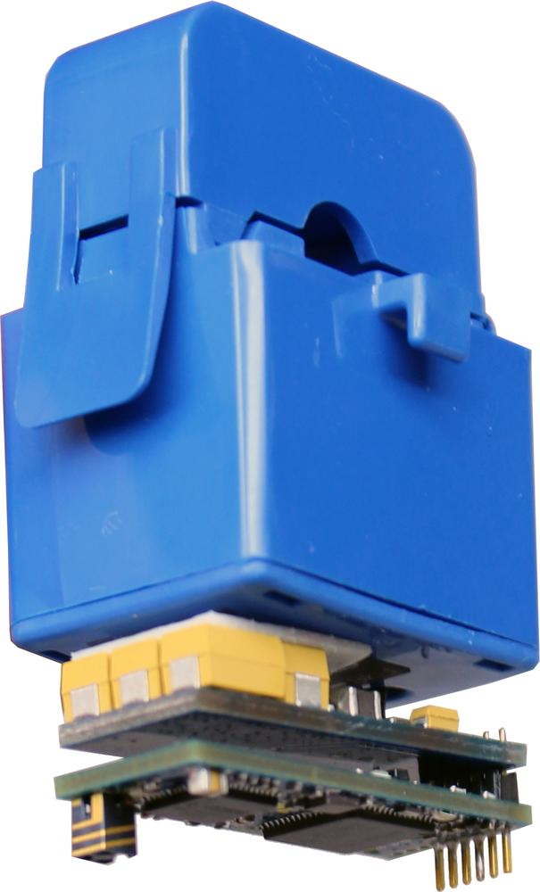
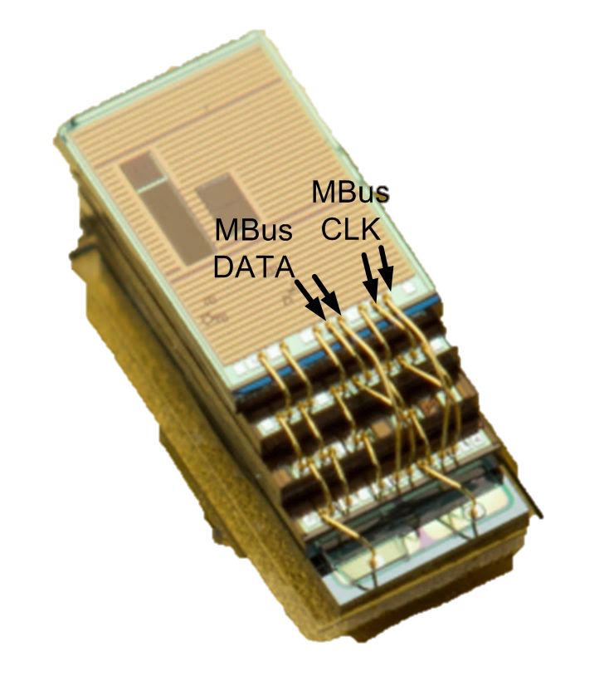
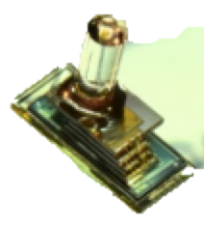
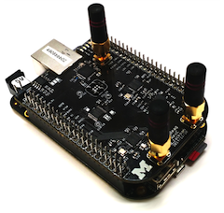
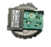
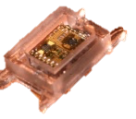
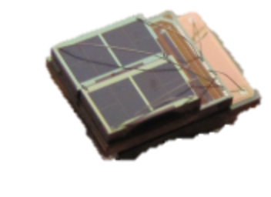
Embedded
Gateway
Cloud
Phone
Mobile &
Peripheral
Devices
Audio
NFC
LP Radio
LP-WAN
Ultrasonic
Vibration
VLC
Wireless
Sensor
Networks
Cloudlet
Smart
Dust
Networks
Gateway
34

Slide 35
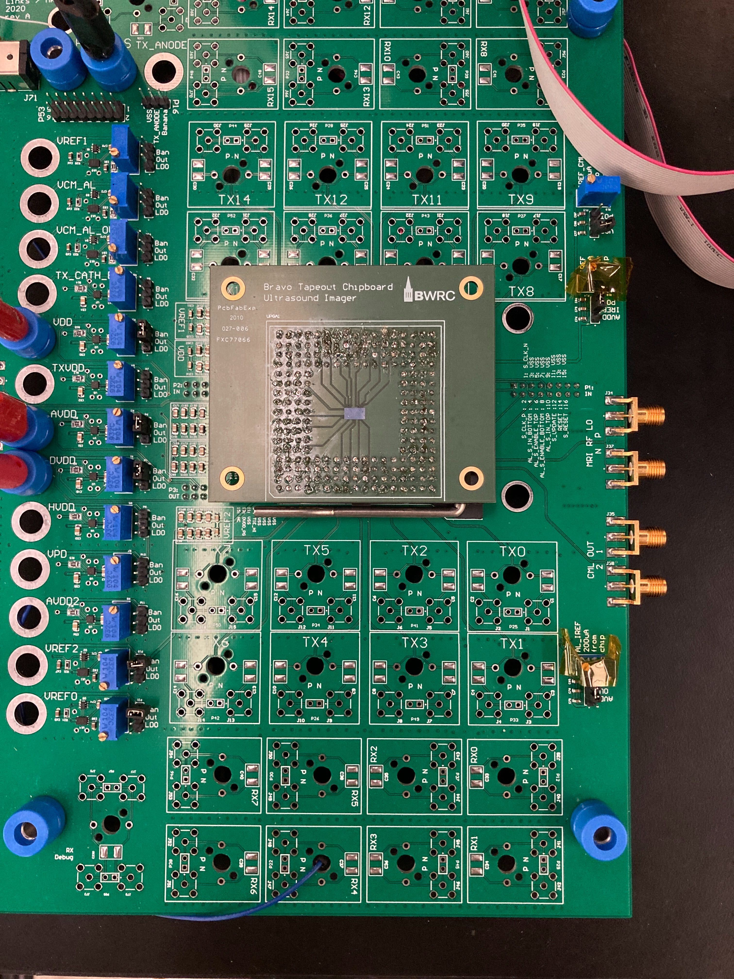
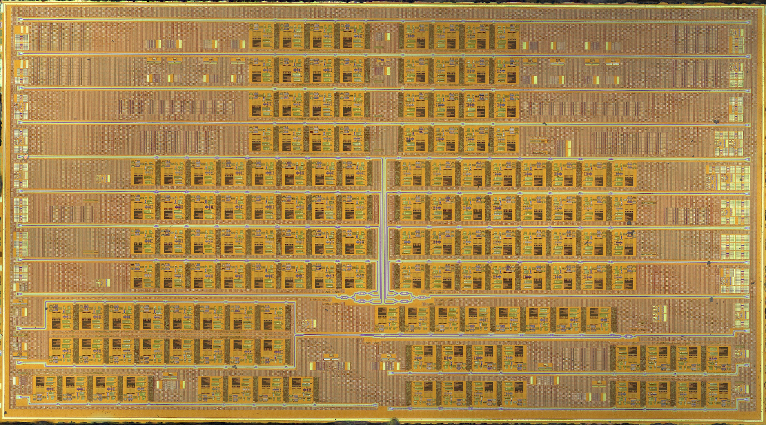
Ultrasound Imaging Using Light
3mm
5.5mm
45nm technology → Billions of transistors!!
Example of a Sensing and Processing System

Slide 36
Module 1: Imaging

Slide 37
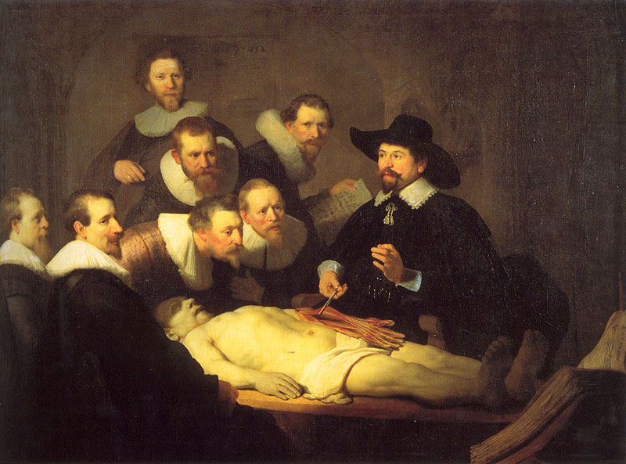
Medical imaging … 1632
Notes:
The anatomy lesson of Dr. Nicolaes Tulp
Painting by Rembrandt

Slide 38
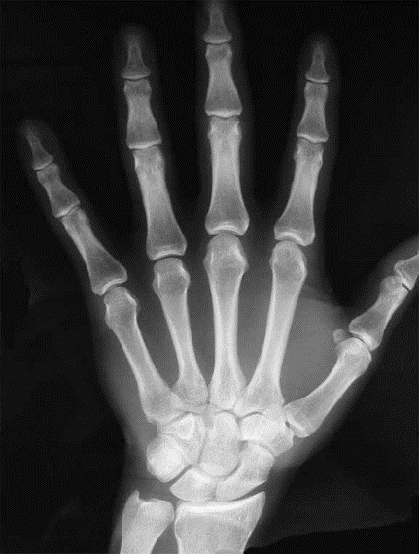
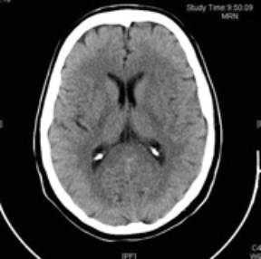
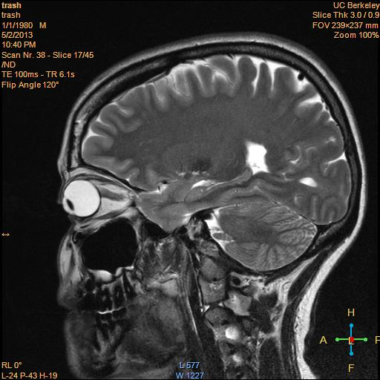
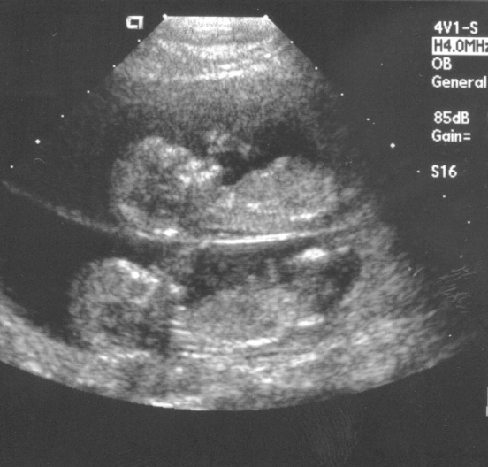
Seeing inside bodies: sans surgery…
MRI
X-Ray
CT
All of these benefitted from the math/hardware design techniques you will learn in this class!
Ultrasound
Notes:
Do you recognize this fine specimen of brain in the MRI? It’s me (Laura Waller)
What does CT stand for? “Computed Tomography”

Slide 39
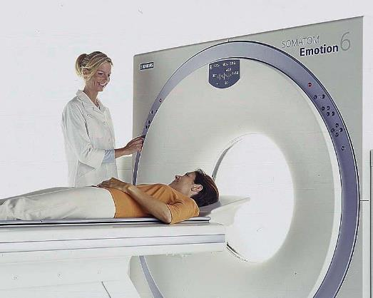
Tomography
Siemens
‘tomo’ – slice
‘graphy’ – to write
Assume it is not desirable to slice open my brain. How does tomography ‘see’ inside?
Notes:
When you don’t understand something, simplify.

Slide 40
Tomography
many measurements
Take measurements.
Measurements are also called projections
Sum of values along the line
1D projections of a 2D object → 2D recovery
2D projections of a 3D object → 3D recovery
Notes:
What does each pixel in the image represent?

Slide 41
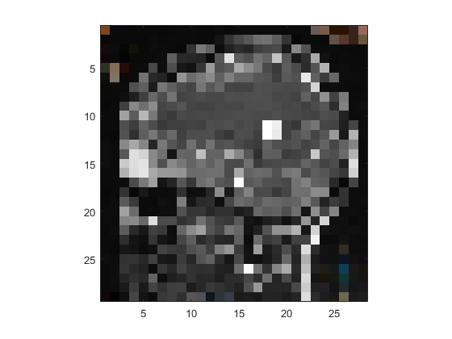
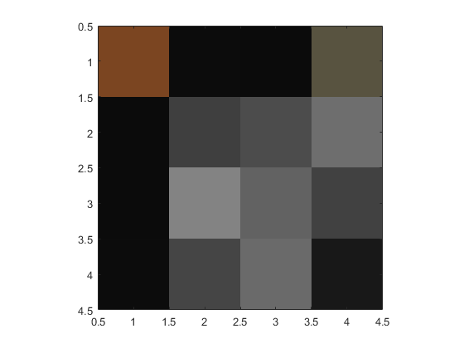


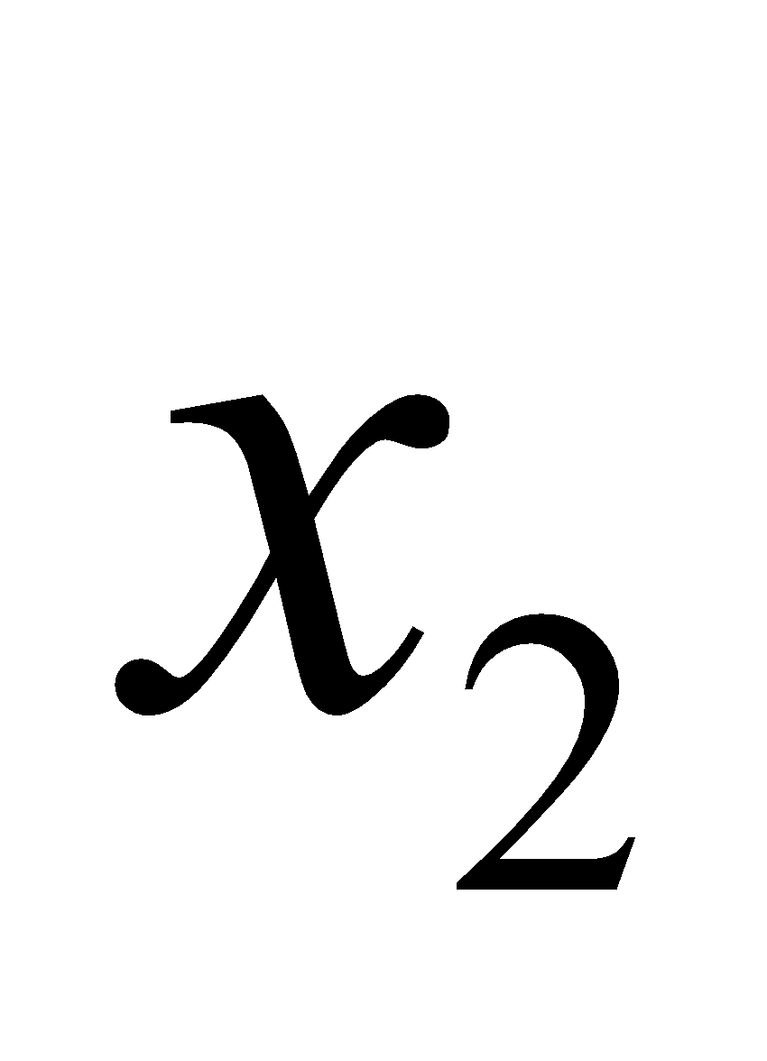







Example: Tomography
e.g. density, absorption, transmittance, etc.
What do pixel values represent?
Can we solve for the pixel values from projections?
Yes, with tomography.
projection intensity
attenuation coefficient
Notes:
First, let’s simplify by reducing the resolution…. A LOT. Now it’s just a 4 pixel image.

